Slide 1
EEE 598 – Reinforcement Learning in Robotics
Fall 2025
Assignment 2 – October 25th , 2025
Eric Everett CODE

Slide 2
Code Structure

Slide 3
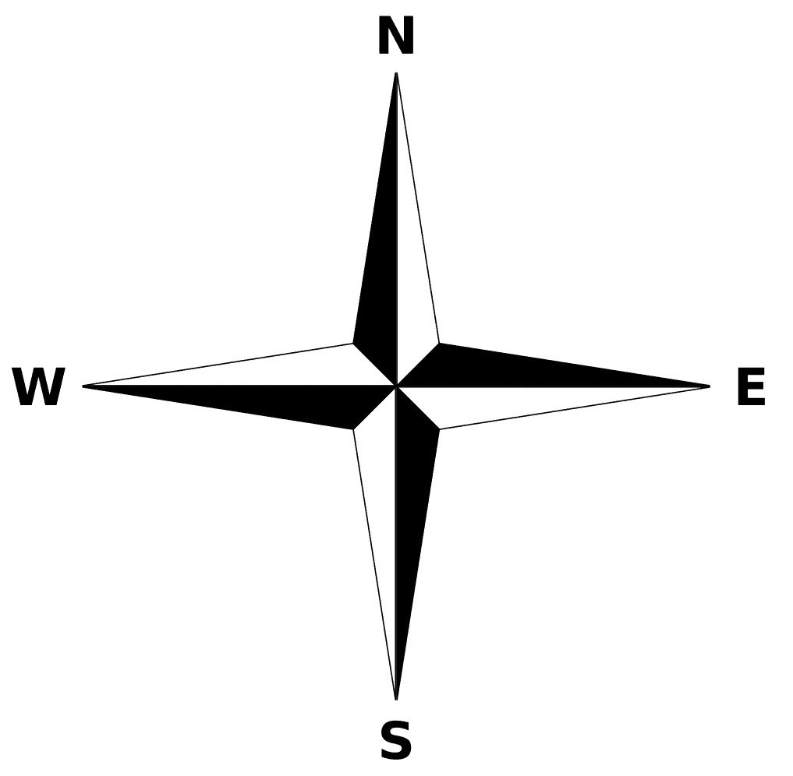
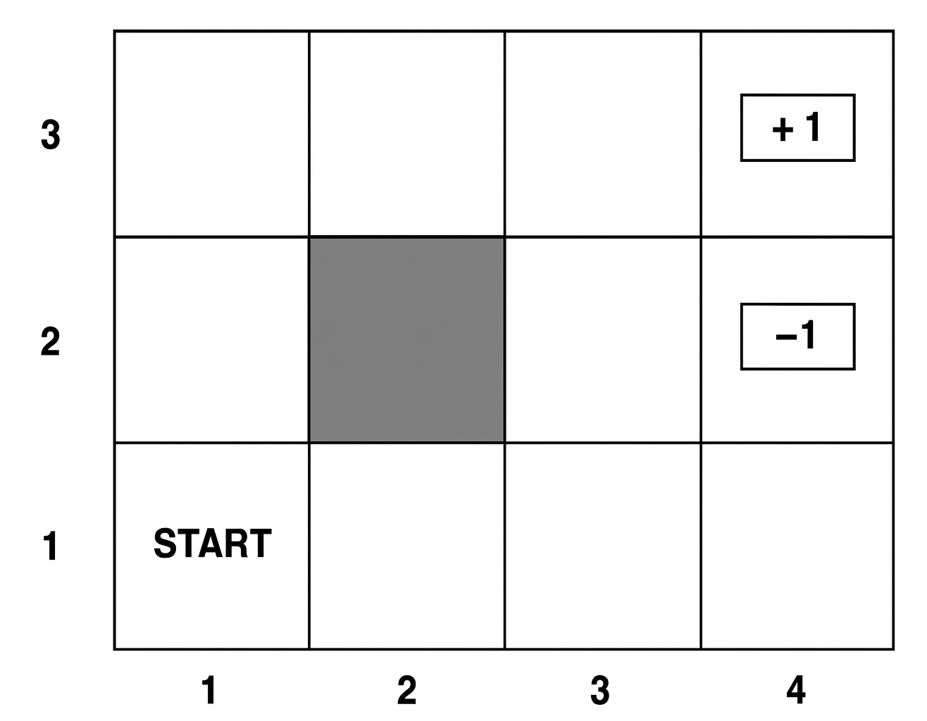
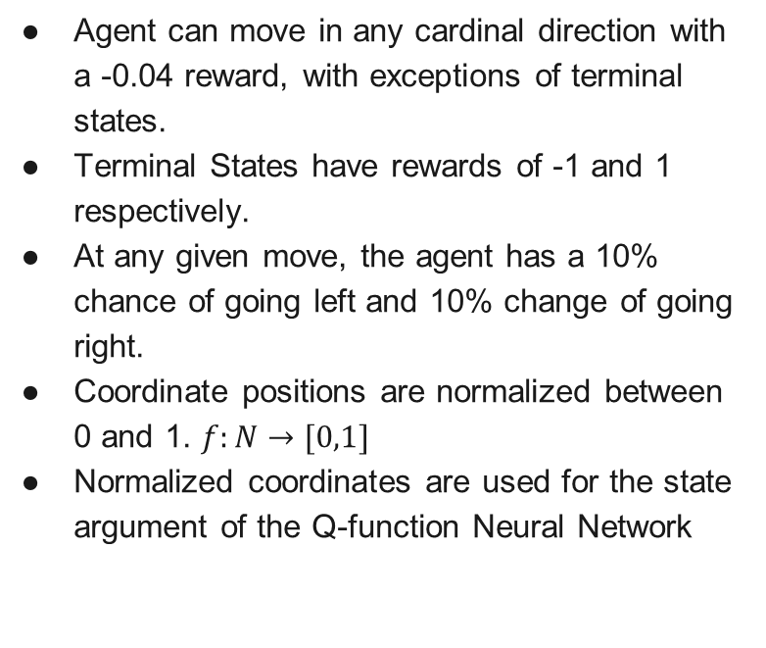
Environment
Agent can move in any cardinal direction with a -0.04 reward, with exceptions of terminal states.
Terminal States have rewards of -1 and 1 respectively.
At any given move, the agent has a 10% chance of going left and 10% change of going right.
Coordinate positions are normalized between 0 and 1. $f:N→[0,1]$
Normalized coordinates are used for the state argument of the Q-function Neural Network
1
0.5
0
0
0.33
0.66
1

Slide 4
Design Choices

Slide 5
Algorithms

Slide 6
Results

